Slide 1
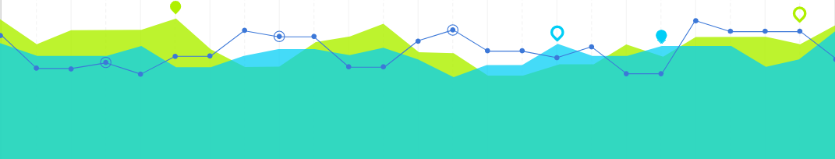




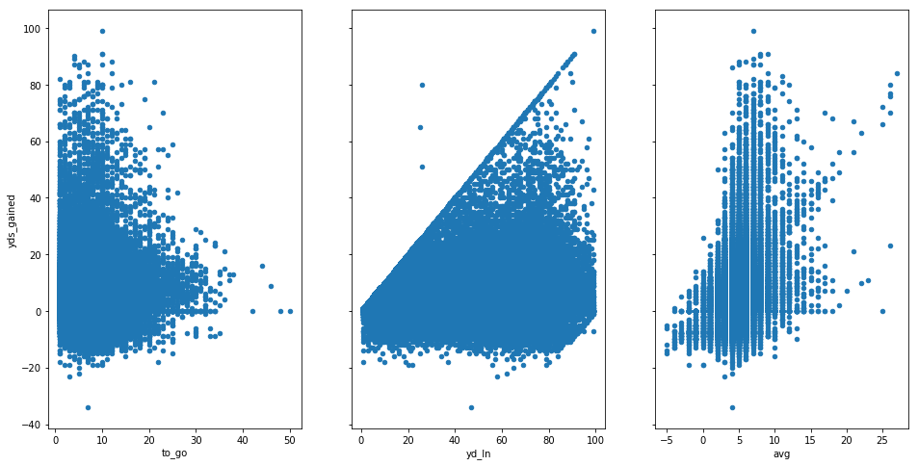
Josh Konowitz - NFL 4th Down Analytics
PREDICTING YARDS GAINED AND FIRST DOWNS:
Yds Gained
Average Error:
Yards Gained: First Downs:
4.66 YDS 14.15%
Punt Distance: FG Completion:
7.41 YDS 11.56%
Yds To Go
Yd Line
Avg. Yds Gained
RANDOM FOREST
REGRESSOR MODEL
LEARNING
OUTCOMES..
Python Libraries
Machine Learning
Data Science
NEXT
STEPS...
Turning Predictions into Insights
PROBLEM: | NFL coaches currently use a ‘gut’ decision-making process on 4th down, resulting in punting on 75% of 4th downs
SOLUTION: | Using machine learning to provide insights for coaches in order to help them make the most optimal decision
TECHNOLOGY:

